Slide 1
Requirements Inception
CSE-311(Fall 2012)

Slide 2
Key Points
Problem Analysis
Business Requirements
Five Steps for Problem Analysis
Vision and Scope Document

Slide 3
Problem Analysis
Problem Analysis Business Requirements Agreement Root Causes Stakeholders Vision & Scope Constraints Document
Goal: gain a better understanding of the problem being solved before development begins
  Identify root cause
  Identify stakeholders and their needs (or problems)
  Identify solution boundary
Uses business requirements obtained from stakeholders
Results in Product Vision and Project Scope

Slide 4
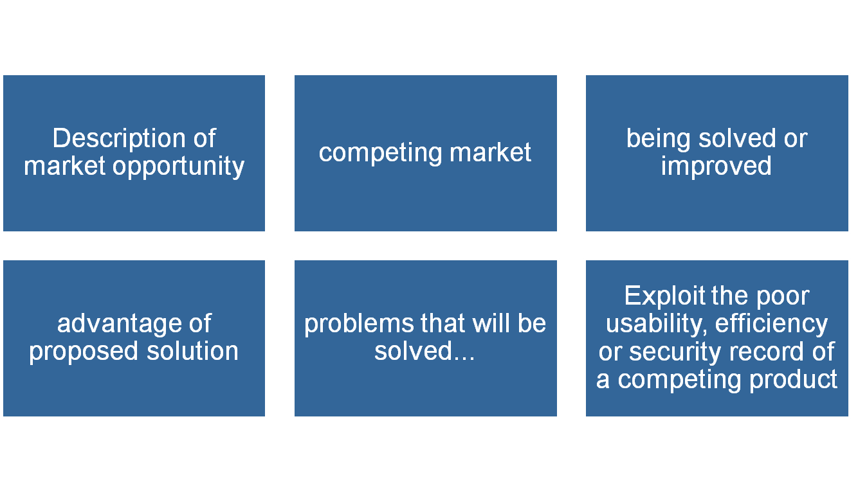
Business Requirements (1)
Problem Analysis Business Requirements Agreement Root Causes Stakeholders Vision & Scope Constraints Document
Business Opportunity

Slide 5
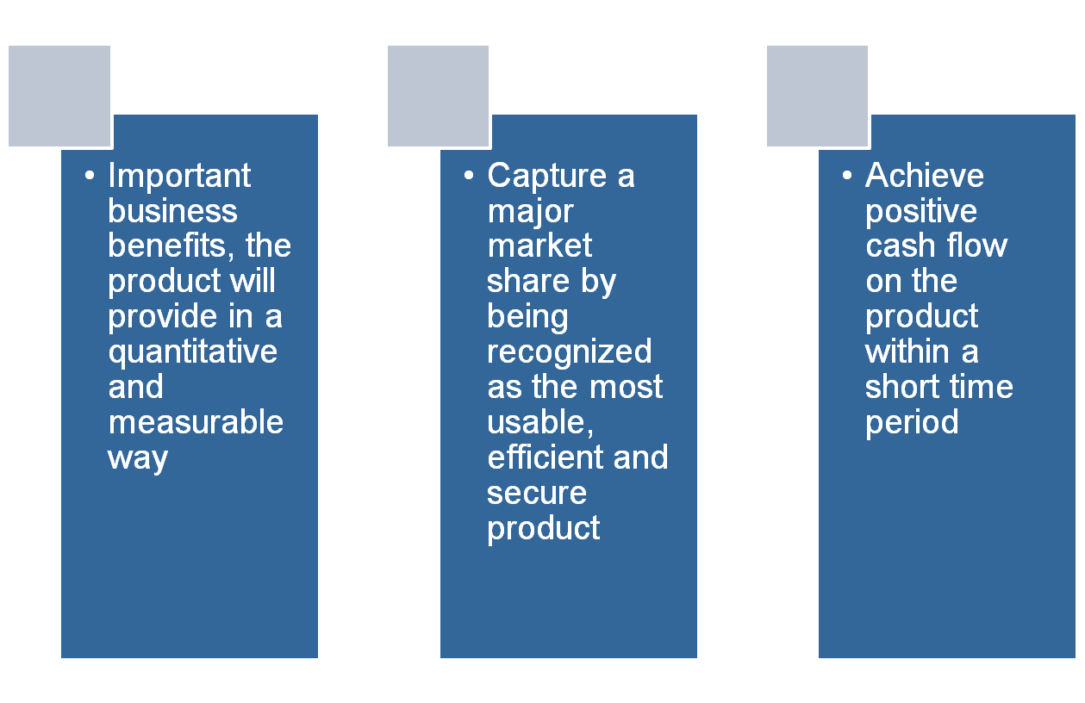
Business Requirements – contd...
Problem Analysis Business Requirements Agreement Root Causes Stakeholders Vision & Scope Constraints Document
Business Objective and Success Criteria

Slide 6
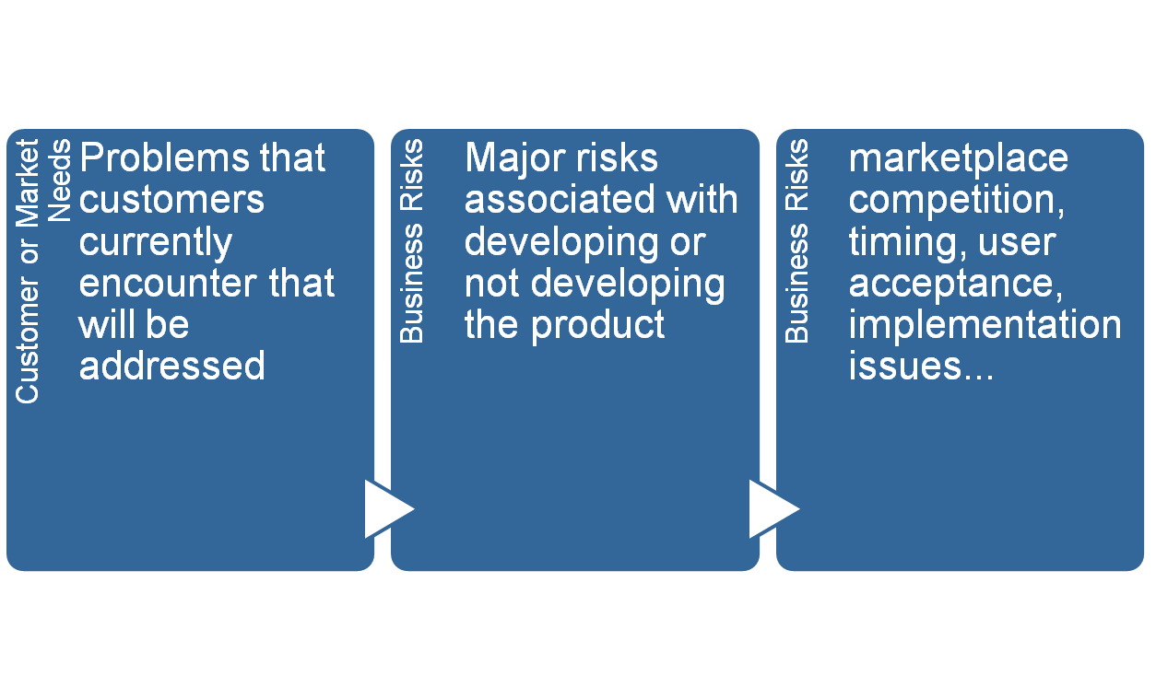
Business Requirements – Contd…
Problem Analysis Business Requirements Agreement Root Causes Stakeholders Vision & Scope Constraints Document

Slide 7
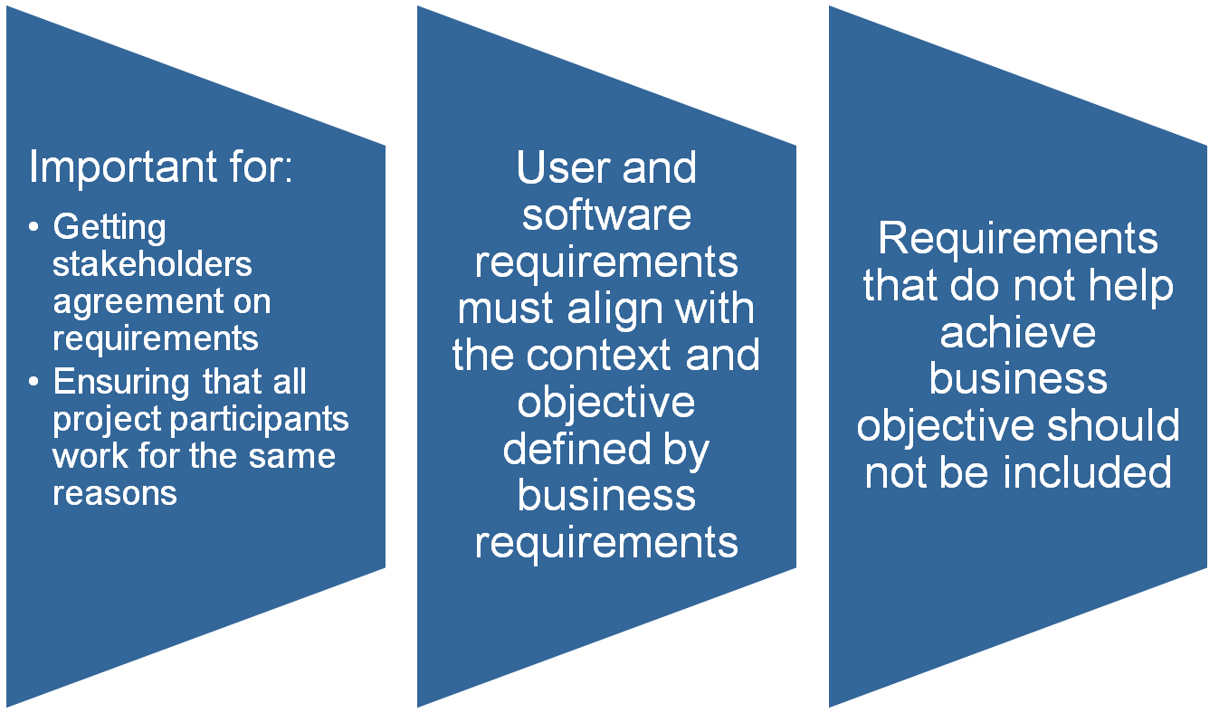
Business Requirements – Contd…
Problem Analysis Business Requirements Agreement Root Causes Stakeholders Vision & Scope Constraints Document

Slide 8
Problem Analysis – Five Steps
Problem Analysis Business Requirements Agreement Root Causes Stakeholders Vision & Scope Constraints Document
Leffingwell and Widrig propose five steps for problem analysis
  Gain agreement on the problem definition
  Understand the root causes – the problem behind the problem
  Identify the stakeholders
  Define the solution system vision and boundary
  Identify the constraints to be imposed on the solution

Slide 9
Problem Analysis – Gain Agreement
Problem Analysis Business Requirements Agreement Root Causes Stakeholders Vision & Scope Constraints Document
Document the problem and seek agreement
  Ask stakeholders to write a problem statement in an agreed format
  Statement should include
    What the problem is?
    Who is affected by it?
    What is the impact?
    Is there a proposed solution?
    What are key benefits?

Slide 10
Gain Agreement on the Problem Definition
One of the simplest ways – Write the problem down and see whether everyone agrees.
Problem Statement Format
Element | Description
The problem | Describe the problem
Affects | Identify stakeholders affected by the problem
Result s | Describe the impact of this problem on stakeholders and business activity
Benefits | Indicate the proposed solution and list a few benefits

Slide 11
Problem Analysis – Understand Root Causes (1)
Problem Analysis Business Requirements Agreement Root Causes Stakeholders Vision & Scope Constraints Document
There is often a problem behind the problem
Root cause analysis consists of finding underlying causes that may not be immediately apparent
Example: Our e­commerce site is not profitable
  Why is it not profitable?
  Poor site design?
  Bad pricing?
  Poor customer management after the sale?
  Some or all of the above?

Slide 12
Problem Analysis – Understand Root Causes (2)
Problem Analysis Business Requirements Agreement Root Causes Stakeholders Vision & Scope Constraints Document
Root cause analysis can be used to understand root causes
  Determine what factors contribute to the problem (sub­problems)
  Recursively determine what factors contribute to these problems
Decompose until causes are understood (possible solution clear)
Source: Leffingwell & Widrig

Slide 13
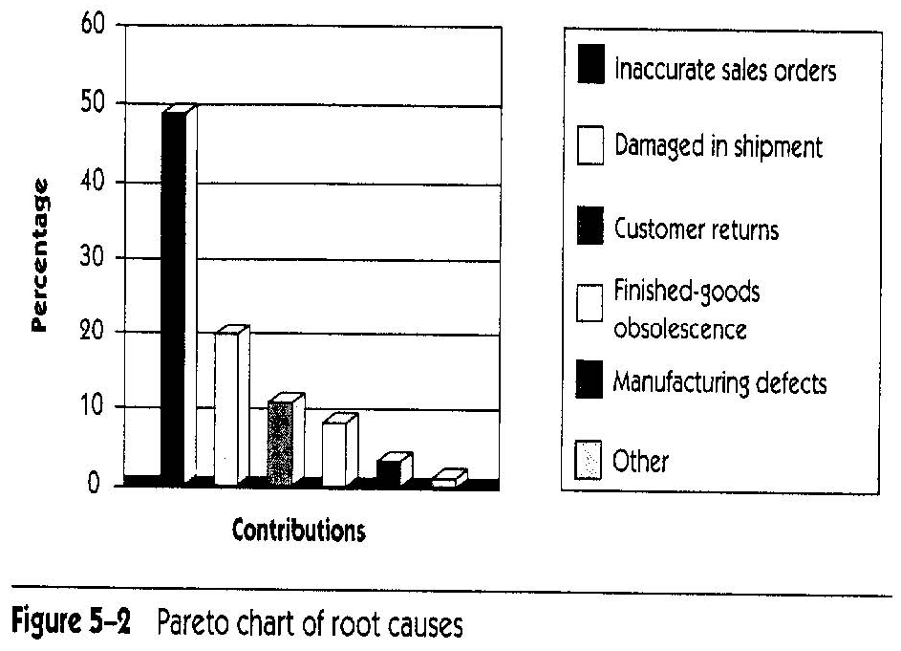
Problem Analysis – Understand Root Causes (3)
Problem Analysis Business Requirements Agreement Root Causes Stakeholders Vision & Scope Constraints Document
Address Root Causes
  Root causes do not all have same impact
  Some may not be worth fixing, at least not now
Estimate relative impact of root causes (e.g., with the help of a Pareto (bar) chart)
Create problem
statement for root
cause problem
identified as worth
solving (and with
computer solution)
Source: Leffingwell & Widrig

Slide 14
Addressing the Root Cause
Elements | Description
The problem | Inaccuracies in sales orders
Affects | Sales order personnel, customers, manufacturing, shipping etc.
Result s | Increased scrap, excessive handling costs, customer dissatisfaction, and decreased profitability
Benefits | A new system to address the problem include Increased accuracy of sales orders Improved reporting of sales data Higher profitability

Slide 15
Problem Analysis – Stakeholder Profiles (1)
Problem Analysis Business Requirements Agreement Root Causes Stakeholders Vision & Scope Constraints Document
Stakeholder Profiles
  Stakeholders are individuals, groups, organizations who are actively involved in the project, are affected by its outcome or are able to influence its outcome
  Profile should include:
    Major value or benefit that stakeholder will receive from product (e.g., improved productivity, reduced rework, cost saving, ability to perform new tasks...)
    Likely attitude toward the product
    Major features and characteristics of interest
    Any known constraints that must be accommodated

Slide 16
Identifying the stakeholders
Stakeholder: Anyone who could be materially affected by the implementation of a new system application
Helpful questions to identify stakeholders:
  Who are the users of the system?
  Who is the customer (economic buyer) for the system?
  Who else will be affected by the outputs that the system produces?
  Who will evaluate the system on deployment?
  Who will maintain the new system?

Slide 17
Identifying the stakeholders – Contd…
Users | Other Stakeholders
Sales order entry personnel(s) | MIS director and development team
Sales order supervisor | Chief financial officer
Production control | Production manager
Billing clerk

Slide 18
Problem Analysis – Product Vision and Project Scope
Problem Analysis Business Requirements Agreement Root Causes Stakeholders Vision & Scope Constraints Document
Product Vision: describes what the product is about and what it could eventually become
  Aligns all stakeholders in a common direction
Project Scope: identifies what portion of the ultimate long-term product vision the current project will address
  Draws boundary between what is in and what is out
Product Vision
Project Scope
for release 1.0
Project Scope
for release 1.1
…..
Project Scope
for release n

Slide 19
Vision Statement (1)
Problem Analysis Business Requirements Agreement Root Causes Stakeholders Vision & Scope Constraints Document
Vision Statement template (according to Moore)
  For [target customer]
  What [statement of the need or opportunity]
  The [product name]
  Is [a product category]
  That [key benefit, compelling reason to buy or use]
  Unlike [primary competitive alternative, current system, or current business process],
  Our product [statement of primary differentiation and advantages of new product]

Slide 20
Define the Solution System Boundary
The system boundary defines the border between the solution and the real world that surrounds the solution.
Information in the form of I/O is passed back & forth from the system to the users living outside the system.
All interactions with the system occur via interfaces between the system and the external world.

Slide 21
Define the Solution System Boundary – Contd…
Thus the world is divided into:
  Our System
  Things that interact with the system or Actors (someone or something, outside the system, that interacts with the system)
Questions to identify actors:
  Who will supply, use or remove information from the system?
  Who will operate the system?
  Who will perform system maintenance?
  Where does the system get its information?
  What other external systems will interact with the system?

Slide 22
Problem Analysis – In-Scope Vs Out-of-Scope
Problem Analysis Business Requirements Agreement Root Causes Stakeholders Vision & Scope Constraints Document
Definition of solution system boundaries
Requirements baseline is defined according to the release scope
New requirements during development are evaluated according to the scope
  New in­scope requirements can be incorporated if they are of
  high priority relative to the other requirements in the baseline
    Usually implies deferring or canceling other requirements or negotiating a new schedule
  Out­of­scope requirements should be deferred to a following release

Slide 23
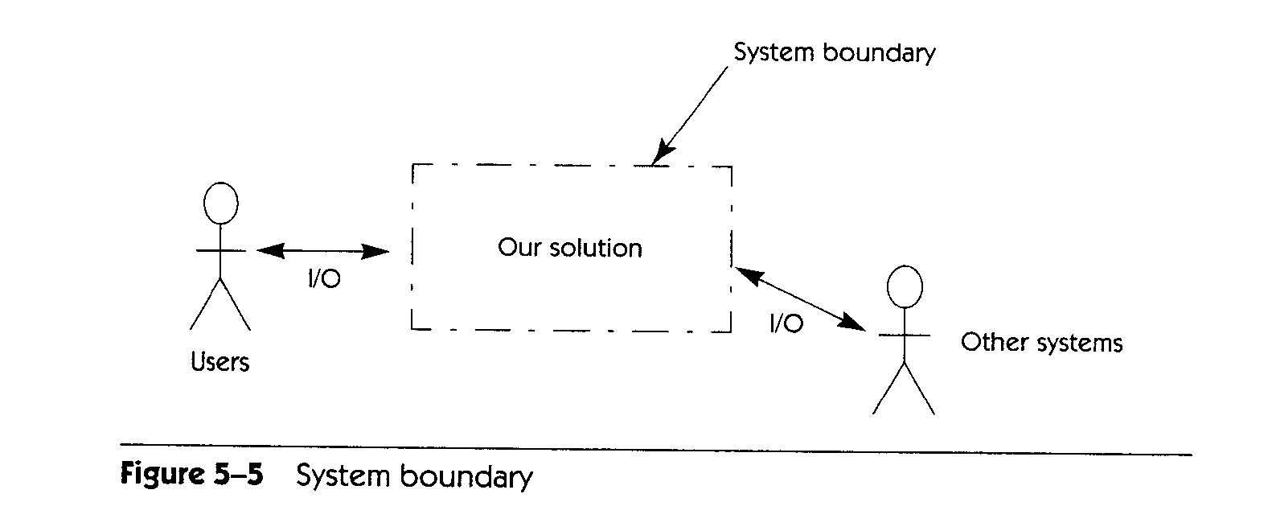
Problem Analysis – System Boundary
Problem Analysis Business Requirements Agreement Root Causes Stakeholders Vision & Scope Constraints Document
Context Diagram
  Top­level view of a system that shows the system’s boundaries and scope
    Identifies terminators outside the system
    Data, control, and material flow between terminators and the system
Source: Leffingwell & Widrig

Slide 24
Identify the Constraints
A constraint is a restriction on the degree of freedom we have in providing a solution.
Each constraint must be carefully considered, it may cause us to reconsider our approach.
Sources of constraints include schedule, ROI, budget, environment, OS, DB, technical issues, clients systems, company policies, choices of tools and languages, personnel or other resource constraints.

Slide 25
Potential System Constraints
Source | Sample Consideration
Economic | Financial or budget constraints
 | Costs of goods or products
Political | Internal or External Political Issues
 | Inter-departmental problems
Technical | Restriction in choice of technology
 | Constraints within existing platform
System | Existing system to be used
 | Compatibility with existing solutions
 | OS to be supported
Environmental | Environmental or regulatory constraints
 | Legal issues
 | Security requirements
Schedule and Resources | Is the schedule defined?
 | Restriction to use existing resources
 | Can resources be expanded? Temporary? Permanent?

Slide 26
Vision and Scope Document (1)
Problem Analysis Business Requirements Agreement Root Causes Stakeholders Vision & Scope Constraints Document
Contents:
  Business requirements
  Vision of the solution
    Vision statement
    Major features (numbered list of major features or user capabilities unique to the new product)
    Assumptions (made while developing vision and scope)
    Major dependencies to external factors outside of the project’s control (e.g., pending industry standards, government regulations, other projects, third party suppliers, development partners)
  Scope and limitation (for initial and subsequent releases)
  Business context

Slide 27
Vision and Scope Document (2)
Problem Analysis Business Requirements Agreement Root Causes Stakeholders Vision & Scope Constraints Document
Contents – Scope and limitations:
  Concept and range of proposed solution
    What the system is
  Limitations
    Capabilities that the product won't include (what the system is not)
    Record rejected requirements with the reason for rejecting them
  Scope of initial release
    Major features planned for initial release
    Acceptable quality characteristics of initial release
  Scope of subsequent releases

Slide 28
Vision and Scope Document (3)
Problem Analysis Business Requirements Agreement Root Causes Stakeholders Vision & Scope Constraints Document
Contents – Business context:
  Project Priorities
    Stakeholders must agree on the project priorities
    Help effective decision making
  Operating Environment
    Environment in which system will be used (e.g., distributed environment)
    Vital availability, reliability, performance and integrity requirements linked to operating environment

